Slide 1
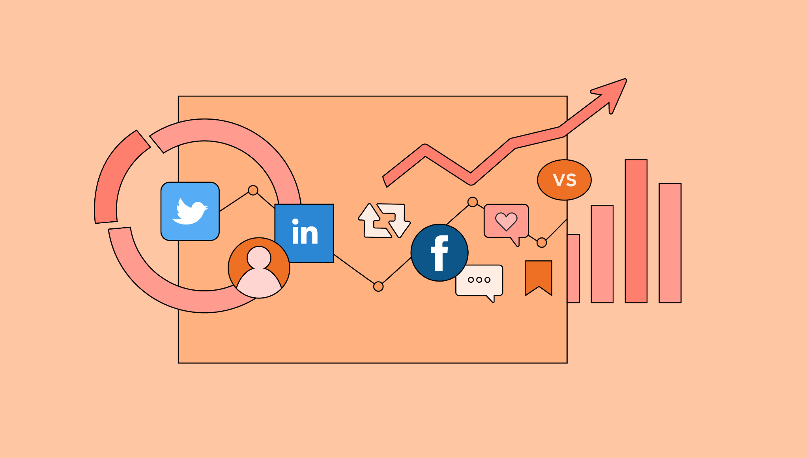

Social Media Analysis
Puja Chowdhury
04/04/2025

Slide 2

Problem Statement
You are hired as a data analyst at Meta and asked to collaborate with the Marketing team. Marketing teams want to leverage Instagram's user data to develop targeted marketing strategies that will increase user engagement, retention, and acquisition. Provide insights and recommendations to address the following objectives.

Slide 3
Data Overview
Data Description
comments_id : unique identifier for each comment
comment_text : text content of a given comment
user_id : unique identifier for each user
photo_id : unique identifier for each photo
created_at : date of interaction in the form like, photos, tags
follower_id : user_id of the follower for a certain user
followee_id : user_id of followee for a certain user
tag_id : unique identifier for each tag
image_url : link to the image posted on the platform
username : username chosen by the user

Slide 4
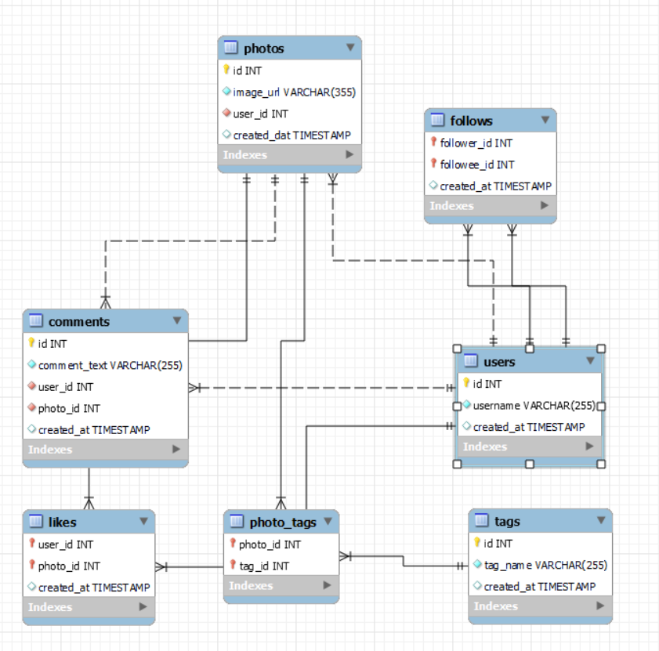
Database schema

Slide 5
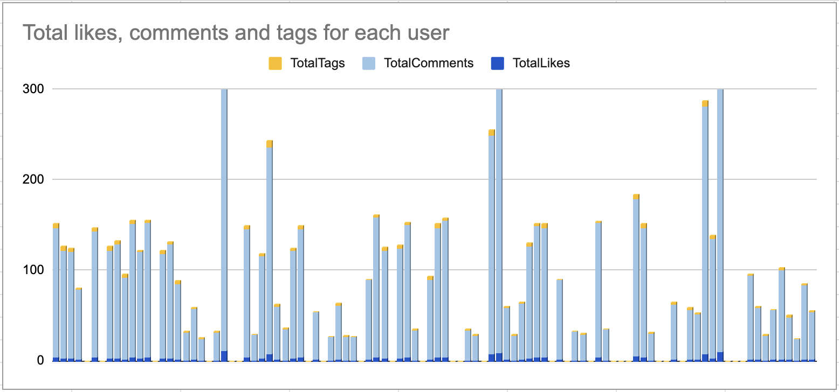
User Engagement Analysis: Insights on Likes, Comments, and Tags
Comments dominate engagement, followed by likes, while photo tags remain minimal.
High-engagement users have over 200 comments, indicating strong community interaction.
Low-engagement users show minimal or zero activity, requiring re-engagement strategies.
Likes and comments are correlated, suggesting that popular photos drive discussions.
Photo tags are underutilized, presenting an opportunity for feature promotion.

Slide 6
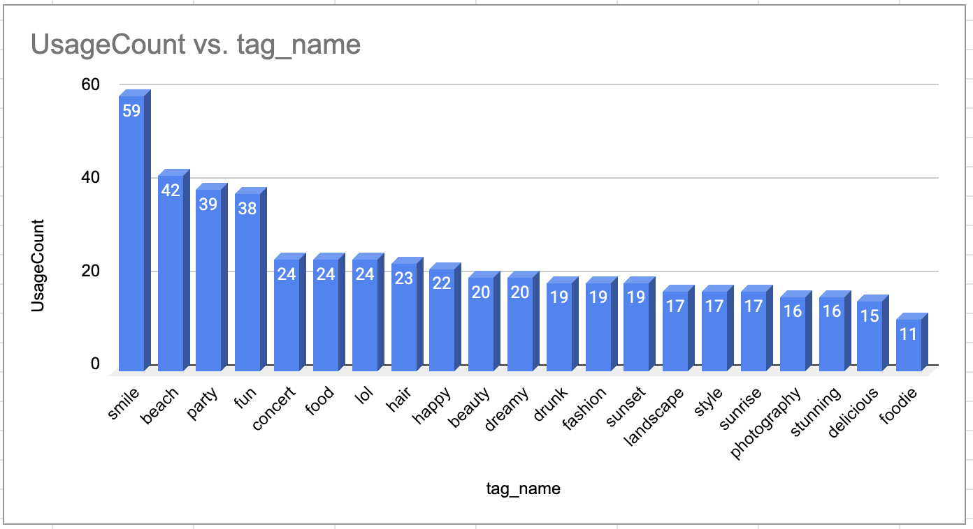
Trending Hashtags Analysis for Targeted Advertising Strategies
Top hashtags (smile, beach, party, fun) indicate high engagement with lifestyle content.
Diverse hashtags reveal different user interests, useful for targeted marketing.
Leveraging trending hashtags enhances ad campaign effectiveness and user engagement.

Slide 7
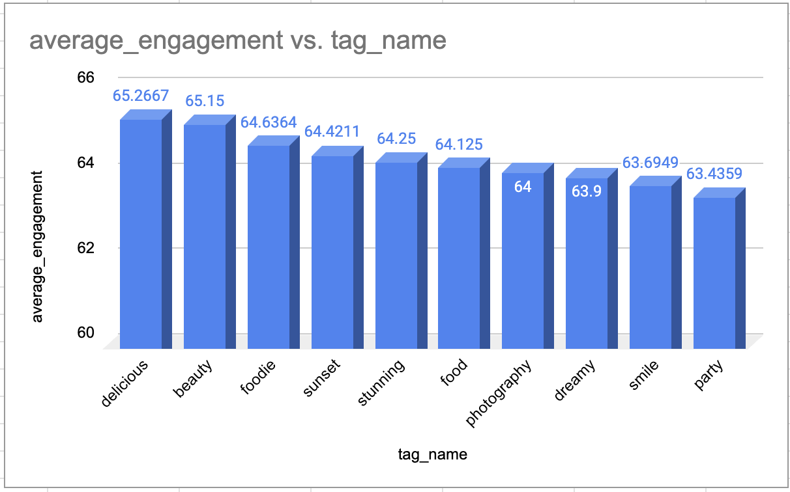
High-Engagement Hashtags: Insights for Content and Ad Strategy
Top hashtags with the highest engagement highlighting popular content themes.
Food, beauty, and photography-related content drive the most engagement, making them ideal for content strategy.
Ad campaigns can integrate these hashtags to target interested audiences, boost visibility, and enhance influencer collaborations.
Optimizing post timing, cross-promotion, and recurring content series can maximize engagement.
Using trending hashtags strategically increases algorithmic reach and content discovery.

Slide 8
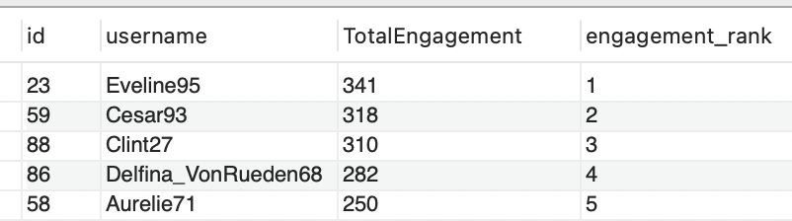
Top Engaged Users: Monthly Engagement Insights & Trends
Engagement Calculation – Engagement is measured as the total of likes, comments, and tags on each user's posts over a month.
Top Performers – Among 100 users, the top 5 most engaged users stand out, with Eveline95 leading in engagement.
User Activity Distribution – A significant gap may exist between top users and the rest, suggesting power users drive platform engagement.
Potential Marketing Strategy – High-engagement users could be leveraged for influencer partnerships or platform growth initiatives.

Slide 9
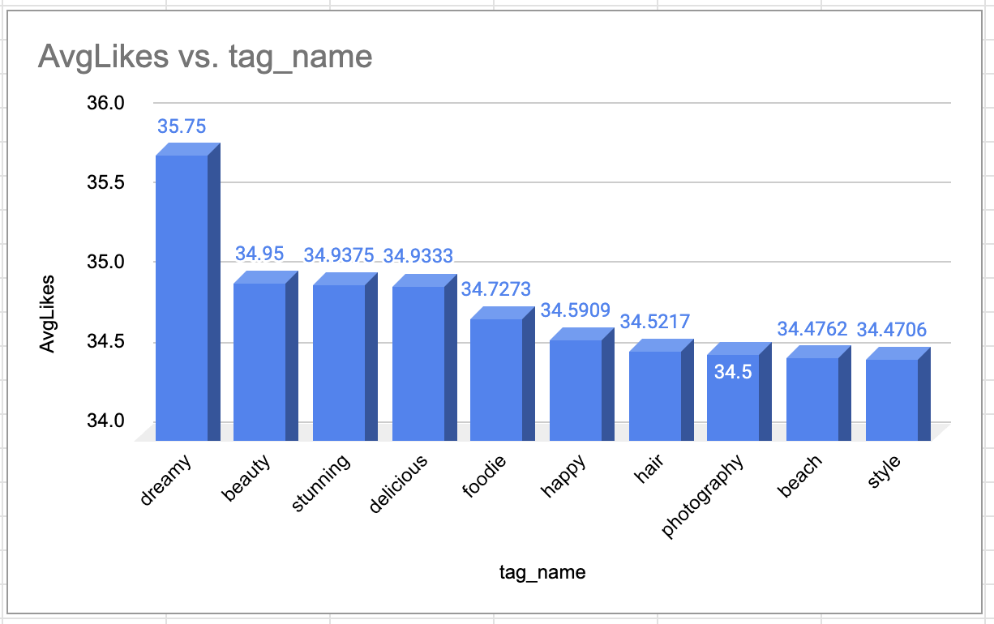
Most Engaging Hashtags: Top Tags with Highest Average Likes
"Dreamy" leads with the highest average likes (35.75), followed by "beauty" and "stunning," indicating strong engagement.
Aesthetic and lifestyle-related hashtags dominate, suggesting visual appeal drives higher interaction.
Brands and content creators can leverage these hashtags to increase visibility and engagement on posts.

Slide 10
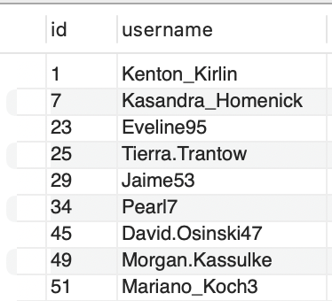
Re-Engaging Inactive Users: Strategies to Boost Platform Activity
23% of users have zero engagement, meaning they receive no likes or comments despite possible posts.
Inactive users present a re-engagement opportunity through personalized ads, notifications, or incentives.
Targeted campaigns can activate this segment, increasing overall platform engagement.

Slide 11
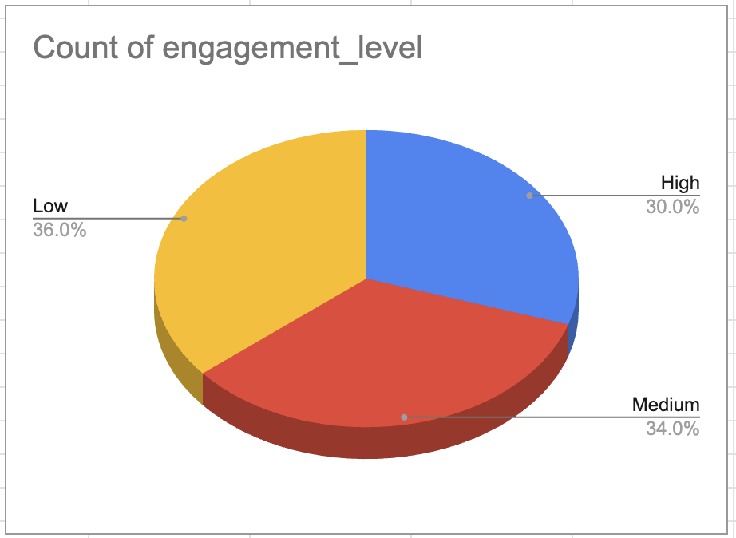
User Segmentation for Targeted Marketing and Personalized Engagement
User Segmentation:
30% High Engagement Users – Active users who frequently interact with content.
34% Medium Engagement Users – Moderately engaged users with potential for increased interaction.
36% Low Engagement Users – Users who require re-engagement strategies.
Targeted Marketing Strategies:
High Engagement Users: Offer exclusive deals, early access, and personalized content.
Medium Engagement Users: Use interactive ads, promotions, and trending recommendations.
Low Engagement Users: Implement re-engagement strategies like reminders, discounts, and curated content.

Slide 12
Instagram Engagement Playbook: Strategies for Growth and Retention
User Engagement Strategies
Content Personalization: Use Instagram Insights to tailor content by demographics and interests.
Hashtag Targeting: Leverage trending, brand-relevant hashtags to boost reach and visibility.
Influencer Collaborations: Partner with influencers aligned with your audience; track performance via Insights.
User Retention Strategies
Re-engagement Campaigns: Target inactive users with personalized content via Stories and Reels.
User Journey Mapping: Analyze behaviors to address drop-offs and optimize the experience.
Loyalty Programs: Encourage continued engagement through rewards and influencer promotion.
Additional Strategies
A/B Testing: Test and optimize content, hashtags, and targeting.
Sentiment Analysis: Use feedback to adjust strategies and improve perception.
Competitor Analysis: Learn from competitors to identify gaps and refine your approach.

Slide 13
Conclusion
Analyze user behavior and preferences using Instagram data to guide strategy.
Develop personalized, relevant content for key audience segments.
Use A/B testing to continuously refine and improve campaigns.
Implement targeted marketing to enhance reach and engagement.
Monitor performance and feedback to replicate successful tactics.
Create data-driven experiences that foster stronger user connections.
Support long-term growth through focused acquisition and retention efforts.

Slide 14


